Slide 1
HIV/AIDS in Nepal
Team United
-Bibesh Manandhar
-Bijesh Ghimire
-Binod Mishra
-Saugat Rai

Slide 2
Challenge
Lack of knowledge about preventive measures and actions to be taken.
Vast and scattered data about HIV/AIDS.
Unclear understanding of data if found.
People, infected by HIV, not aware about the health service and facilities provided.
Creating Understanding among people about the disease.

Slide 3
Solution
‘Data must be open.’ –Providing data for those who required.
Providing HIV/AIDS related information in one portal.
Information about the preventive measure taken to control and fight with them.

Slide 4
Impact
Making people aware about HIV/AIDS.
Get information about HIV/AIDS all in one portal.
Making people aware about HIV/AIDS.
Doctor-patients contact.

Slide 5
Product Features
Providing HIV/AIDS related information in one portal.
To provide access to information for people living with HIV/AIDS.
Visualization of Past and Current data records of HIV/AIDS patients with the help of various data and charts.
Providing information for Government as well as various NGOs and INGOs working towards the HIV infected patients.
Subscribe for Newsletter about coming up events.
Information about Hospital for treatment on map.

Slide 6

Screenshots

Slide 7
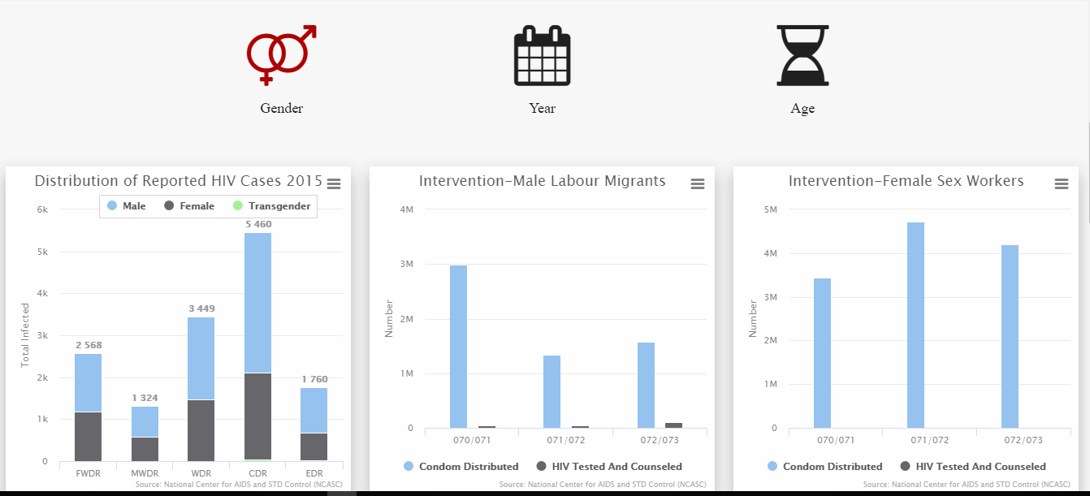
(Data Distribution)

Slide 8
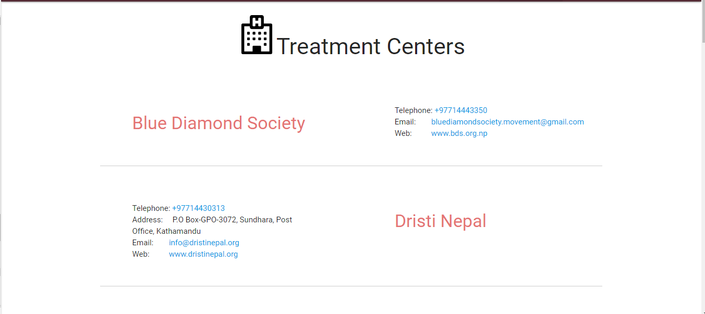

Slide 9
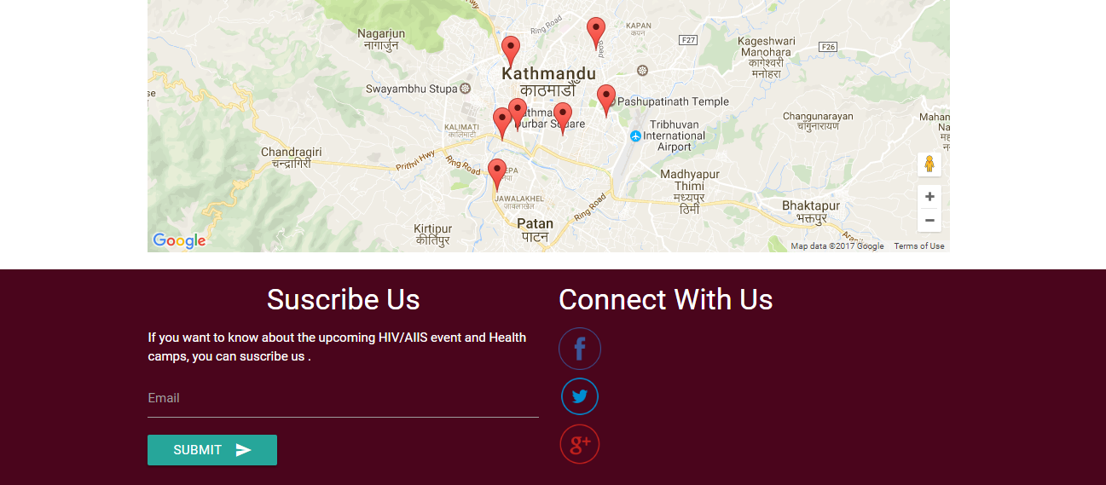

Slide 10
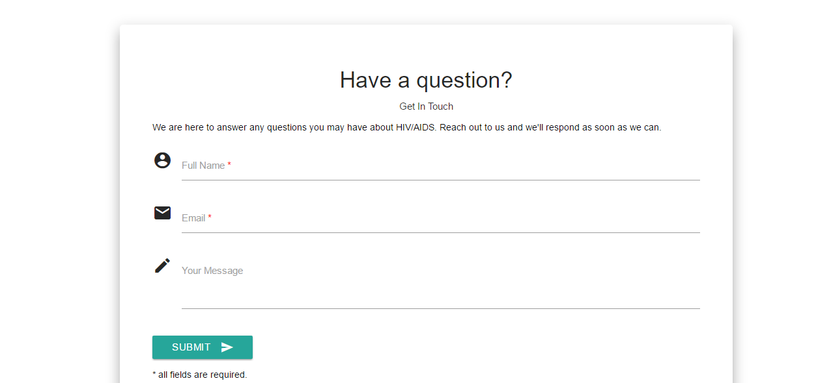

Slide 11

In Future…
Developing Mobile Application.
Login and Forum features.
Donation.
Dynamism for data entry.
Health Camps.
Volunteer Raising.

